Slide 1
Test Strategy
<Project Name>
<Project id>

Slide 2
Test Strategy Document History
Document Information
Document Name | <Project Name> Test Strategy Document
Status | Draft/ Signed-off
Date Last Edited (dd-mmm-yyyy)
Document Author | <Author Name, E2E Test Manager>
File URL
Consulted with
Version | Name | Role | Date
 |  | <Project Manager>
 |  | <GIS>
 |  | <Technology Services>
 |  | <Technology Support Manager>
Version History
Version | Revision Date | Updated by | Summary of Changes
Sign-off
Version | Name | Organisation/Role | Date
 |  | <Organisation>/ Business Stakeholder
 |  | <Application Owner>
By signing off, the sign-off parties acknowledge that they are signing-off the Test Strategy based on the risk appetite of technology and the business. Endorsement from the PWC and/or PSC to be obtained if there are changes made after signed-off.
<Attached Sign-off Email Here>
Supporting Documents/ URL
Version | Document Name | URL
 | <Business Requirement Document>

Slide 3
Contents
Project Overview and Architecture
Testing Scope of the Project
In-Scope Applications and Test Phases (UT, ST, SIT, UAT, Regression)
In-Scope Applications and Non-Functional Test Phases
Out of Scope Applications and Functions
Test Approach
Testing Techniques
Test Evidence
Test Data Requirements
Test Environment Requirements
Test Responsibilities
List of Dispensations Obtained
RAID Log
References
Appendix
    A. Test Milestones and Deliverables
    B. Contact List

Slide 4
1. Project Overview and Architecture
Purpose
The purpose of this document is to outline the detailed Test Strategy for <Project/Release name> . This document details the testing scope, phases, approach, entry and exit criteria, test management activities and identifies the test teams involved.
Project / Release Overview
<Provide a brief overview of the project along with a simple architecture diagram based on the architecture document> <List the project goals and how testing will help to achieve these goals> <Revisit and document any other regulatory requirement>
Notes:
The text

Slide 5
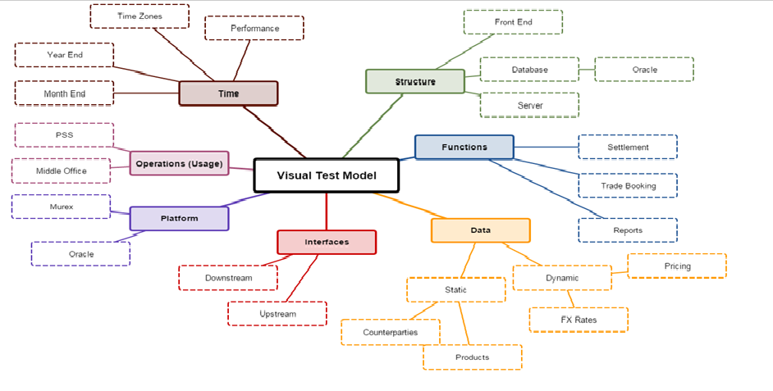
2. Testing Scope of the Project
<Outline the scope of testing with a diagram that depicts the full testing landscape of the project.>
< FreeMind mind mapping tool can helps facilitate this and can be installed by raising a RMS request. Given below is an example. >
<For frequent /multiple releases, provide the general outline of the testing scope, capture the updated information separately (in Confluence/Teamsite/Bridge) and provide the link to that information. >

Slide 6
3. In-Scope Applications and Test Phases (UT, ST, SIT, UAT, Regression)
Mandatory test phases are marked as ‘M’. Indicate ‘NA’ if the application intends to skip a mandatory test phase. Refer to the SCB Detailed Testing Guidelines for more guidance.
< Specify the planned number of cycles for SIT and UAT.>
< For each application, choose and specify one of the options provided under ‘Impact of Project on Application’. >
< Specify in which test phase(s) the Regression Test will be performed. >
< E2E Test Manager to include all other relevant functional testing. >
<For frequent/multiple releases, provide the up to date information at the time of documenting this Test Strategy, capture the updated information separately (in Confluence/Teamsite/Bridge) and provide the link to that information. >
Application Name | Impact of Project on Application | UT | ST | SIT X cycles | UAT Y cycles | Regression Test
<Application 1> | <In this column, specify one of the options from below: Application has changes Application has no changes but is impacted by project - Application is needed for testing purpose only > | M | M | M | M | <Test Phase/s in which Regression Testing will be performed. > <If application has No changes but is impacted by changes in project, then the application should go through regression testing.>
Example: eBBS | Application has changes For both UAT and SIT model country approach will be used. | M | M | M | M | -Regression Testing will be performed during UAT An Automation Core Regression will be executed on the upgraded version of eBBS release e11.29 with coverage on the basic modules.

Slide 7
4. In-Scope Applications and Non-Functional Test Phases
Mandatory test phases are marked as ‘M’. Indicate ‘NA’ if the application intends to skip a mandatory test phase. Refer to the SCB Detailed Testing Guidelines for more guidance.
< For each application, choose and specify one of the options provided under ‘Impact of Project on Application’. >
< E2E Test Manager to include all other relevant non-functional testing. >
<For frequent/multiple releases, provide the up to date information at the time of documenting this Test Strategy , capture the updated information separately (in Confluence/Teamsite/Bridge) and provide the link to that information. >
Application Name | Impact on Application | *Performance Test (PT) | **Failover & Recovery Test | Security Test | ***Data Migration | OAT
<Application 1> | <In this column, specify one of the options from below: Application has changes Application has no changes but is impacted by project - Application is needed for testing purpose only > | M | M | M | M | M
Example: eBBS | Application has changes | M | NA | M | NA | M
*Performance Test (PT) is mandatory for:
- BC 4 and 5 rated applications.
- e-banking applications (refers to financial services (transactional, enquiry or payment services) provided to personal or business customers and delivered over the Internet, wireless networks, automatic teller machines (ATMs), fixed telephone networks or other electronic terminals or devices)
BC 3,2, and 1, impact assessment need to be performed to determine if PT required.
- New applications
**Failover & Recovery Test is mandatory for new software and releases on new infrastructure​.
*** Data Migration is mandatory for Data Migration/Conversion projects.

Slide 8
5. Out of Scope Applications and Functions
Specify the applications and functions that will not be tested in this project. Indicate the reasons why they are out of scope and the impact for exclusion.
<For frequent/multiple releases, provide the up to date information at the time of documenting this Test Strategy , capture the updated information separately (in Confluence/Teamsite/Bridge) and provide the link to that information. >
Application Name | Functions | Reasons | Risk Impact
<Application 1> | <Function 1> | <Reason why is it out of scope> | <Impact for exclusion>
 | <Function 2> | <Reason why is it out of scope> | <Impact for exclusion>
 | <Function 3> | <Reason why is it out of scope> | <Impact for exclusion>
<Application 2>
<Application 3>

Slide 9
6. Test Approach
Specify the high level test approach to be taken for each applicable test phase(s) for the project. For every test phase in scope as per sections 3 and 4, include a row in the table and describe the test approach.
<For frequent/multiple releases, provide the up to date information at the time of documenting this Test Strategy, capture the updated information separately (in Confluence/Teamsite/Bridge) and provide the link to that information. >
Test Phase | Test Preparation Approach | Test Execution Approach | Test Tools | Responsible Team
<Test Phase> | <Explain the approach to be followed for test preparation activities for each test Phase; test automation, parallel test execution if planned, reuse of test cases and data if planned> | < Example, Will there be an overlap with the previous test Phase; Will there be automated testing; Will regression test be conducted> | <Specify the test tools to be used> | <Specify the team(s) responsible for delivering the test>
UT
ST
SIT
UAT
PT
Failover & Recovery
Security Test
Data Migration
OAT

Slide 10
7. Testing Techniques
Specify the different testing techniques that will be carried out and in which testing phase/s they will be performed.
Refer to the SCB Detailed Testing Guidelines for the list of the different testing techniques.
No | Testing Techniques | Test Phase/s |  | No | Testing Techniques | Test Phase/s
1 | Example: Equivalence Partitioning | ST |  | 13
2 |  |  |  | 14
3 |  |  |  | 15
4 |  |  |  | 16
5 |  |  |  | 17
6 |  |  |  | 18
7 |  |  |  | 19
8 |  |  |  | 20
9 |  |  |  | 21
10 |  |  |  | 22
11 |  |  |  | 23
12 |  |  |  | 24

Slide 11
8. Test Evidence
The following table specifies the format of test evidence that will be required for each test phase to demonstrate that testing was completed as expected. Test evidence is mandatory for all test phases.
Test Phase | Test Evidence | Location of Test Evidence
UT | <Test evidence should be in the form of log files, transaction reports, screen shots, and automated test runs. Example: Log files > | <Provide the link to Confluence/Teamsite/Bridge/PDR>
ST
SIT
UAT
PT
Failover & Recovery
Security Test
Data Migration
OAT

Slide 12
9. Test Data Requirements
The following table specifies test data required for each test phase. The default test data to use for UT and ST would be “simulated test data” . Teams must adhere to the Global Information Security (GIS) portal: “Production Data for Testing – Guideline” for guidance when using production data.
<For frequent/multiple releases, provide the up to date information at the time of documenting this Test Strategy , capture the updated information separately (in Confluence/Teamsite/Bridge) and provide the link to that information. >
Application Name | Test Phase | Data Requirements
<Application 1, Example: Finantix> | <Test Phase, Example: UT> | <Example : Simulated test data >
<Application 1, Example: Finantix> | <Test Phase, Example: ST> | <Example : Simulated test data >
<Application 1, Example: Finantix> | <Test Phase, Example: SIT> | <Example : Simulated test data >
<Application 1, Example: Finantix> | <Test Phase, Example :UAT> | <Example : Masked production data>

Slide 13
10. Test Environment Requirements
The following table specifies details of test environment for each test phase. If application has any specific test environment requirement(s) (or limitation), specify them in table below. Examples: shared test environment with another project. See Test Environment Standards for more information.
<For frequent/multiple releases, provide the up to date information at the time of documenting this Test Strategy , capture the updated information separately (in Confluence/Teamsite/Bridge) and provide the link to that information. >
Application Name | Env Needs | Test Environment Requirements
 |  | Functional Test |  |  | Non-Functional Test |  |  |  |  | Remarks
 |  | ST | SIT | UAT | PT | Failover & Recovery | Security Test | Data Migration | OAT
<Application 1, Example: Finantix> | Separate Test Environment? | N | N | N | Y | NA | Y | NA | Y | <Example, SIT and UAT will share the same environment as ST. Data used will not be overlapping and any downtime/maintenance time has been agreed and factored into this project. PT , Security Test and OAT will be separate environment altogether >
 | Date Needed By | 20 Feb | 1 Mar | 15 Mar | 25 Mar | NA | 30 Mar | NA | 5 Apr
<Application 2> | Separate Test Environment?
 | Date Needed By

Slide 14
11. Test Responsibilities
In the following table, for each applicable test phases, include applications and teams responsible for delivery.
<Attached a detail contact list in the Appendix B. Contact List>
<For frequent/multiple releases, provide the up to date information at the time of documenting this Test Strategy, capture the updated information separately (in Confluence/Teamsite/Bridge) and provide the link to that information. >
Test Phase | Team Responsible for Testing | Test Manager Responsible
UT | <Provide for each application in scope. Example: Finantix –Vendor & Development team> | < Name>
ST
SIT
UAT
PT
Failover & Recovery
Security Test
Data Migration
OAT

Slide 15
12. List of Dispensations Obtained
The following table specifies all the dispensations that have been obtained in relation to this Test Strategy not following the standard test process. Refer to the Test Dispensation – Guidelines and User Guide for more information.
Dispensation ID | Description | Dispensation Status
<Jira Id> | <Brief description of dispensation> | <Refer to “Status” field in JIRA to get the latest status>
Note: All dispensation listed in this section must be logged in the following section - RAID Log

Slide 16
13. RAID Log
The following table specifies risks, assumptions, issues and dependencies that apply specifically to this project.
<For frequent/multiple releases, provide the up to date information at the time of documenting this Test Strategy , capture the updated information separately (in Confluence/Teamsite/Bridge) and provide the link to that information. >
<For example, consider the risk of any applications that will not be deployed through the standard SCM process.>
Phase of Item | Description | Severity | Impact | Mitigation Plan
<Risk> | <Provide description of the item> | <High/Medium/Low> | <Specify how risk Impacts the product/release> | <Provide the actions to lessen the impact >
<Assumption>
<Issue>
<Dependency>

Slide 17
14. References
Document Reference | Link/URL | Owner/Application

Slide 18
Appendix
<Please add any other relevant information in this section>

Slide 19
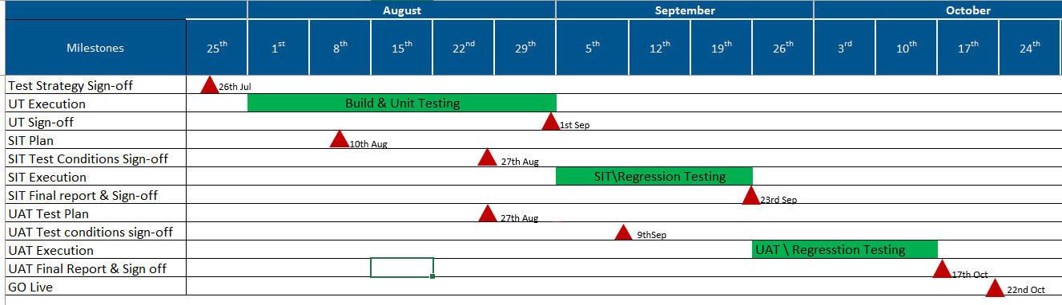
A. Test Milestones and Deliverables
<Specify test schedule below showing key milestones. Given below is an example. Attached here is a spreadsheet which can be used for this planning>
<Provide the up to date information at the time of documenting this Test Strategy , capture the updated information separately (in Confluence/Teamsite/Bridge) and provide the link to that information. >

Slide 20
B. Contact List
<For frequent/multiple releases, provide the up to date information at the time of documenting this Test Strategy , capture the updated information separately (in Confluence/Teamsite/Bridge) and provide the link to that information.
Attached here is a spreadsheet which can be used >
Tech Delivery Head
<Name>
Delivery Manager
<Name>
E2E Test Manager
<Name>
Test Manager1
<Name, Application(s)>
Test Manager2
<Name, Application(s)>
Test Manager3
<Name, Application(s)>
Test Manager4
<Name, Application(s)>
PT Manager
<Name>
Security Test Manager
<Name>
OAT Manager
<Name>
Failover and Recovery Test Manager
<Name>
Test Manager5
<Name, Application(s)>
Test Manager6
<Name, Application(s)>
Test Manager7
<Name, Application(s)>
Test Manager8
<Name, Application(s)>
Data Migration Manager
<Name>
Note: Whichever applicable.

